Slide 1
FDA’s “Closer to Zero” and the Future of Federal Heavy Metal Regulation
ASTA 2021 Regulatory Workshop
August 4, 2021

Slide 2
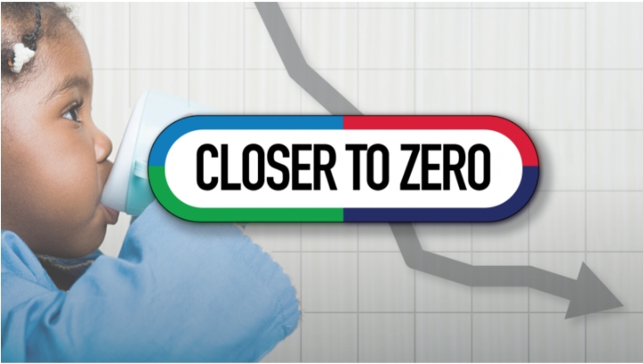
Agenda
Background and Timeline of Key Developments
FDA’s “Closer to Zero” Report
Forecast for the Future

Slide 3
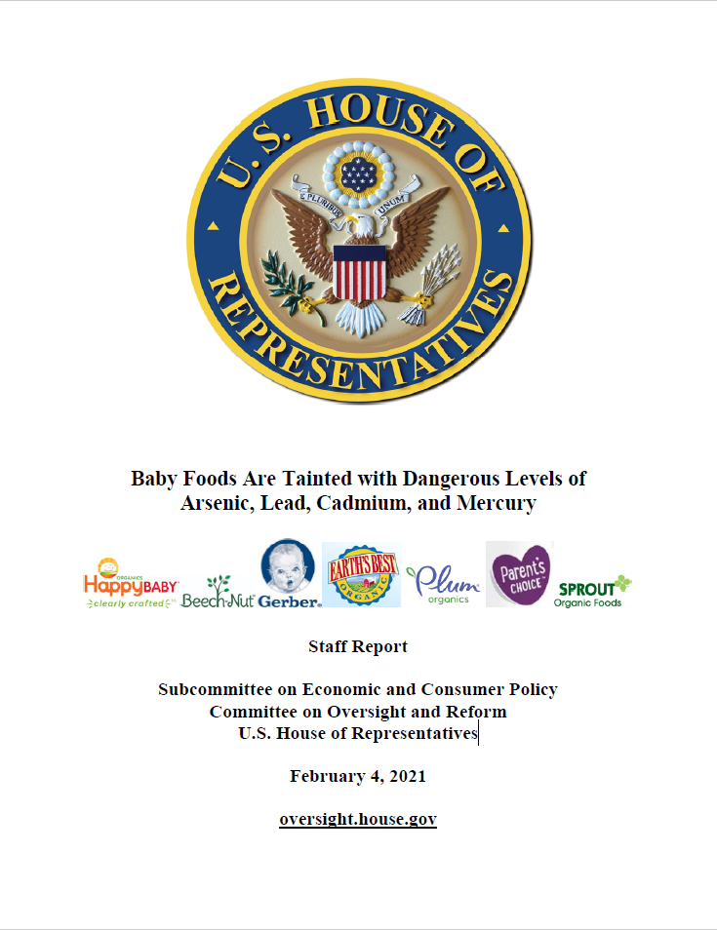
Background/Timeline
August 2018: Consumer Reports publishes report with levels of arsenic, cadmium, and lead in baby and toddler foods
“Heavy Metals in Baby Food: What You Need to Know”
February 4, 2021: Congressional Staff Report published
“Baby Foods Are Tainted with Dangerous Levels of Arsenic, Lead, Cadmium, and Mercury” – Staff Report, Subcommittee on Economic and Consumer Policy, Committee on Oversight and Reform, U.S. House of Representatives

Slide 4
Background/Timeline
February 16, 2021: FDA Constituent Update “FDA Response to Questions About Levels of Toxic Elements in Baby Food, Following Congressional Report”
March 5, 2021:
FDA Constituent Update: “FDA Letter to Industry on Chemical Hazards, including Toxic Elements, in Food and Update on FDA Efforts to Increase the Safety of Foods for Babies and Young Children”
FDA Letter to Baby and Toddler Food Manufacturers and Processors
March 25, 2021: Legislation was introduced in Congress in 2021 that would set new maximum levels of toxic heavy metals in baby food and require manufacturers to comply within 1 year (Baby Food Safety Act of 2021)

Slide 5
Closer to Zero – Overview
On April 8, 2021, FDA released “Closer to Zero: Action Plan for Baby Foods”
The plan identifies the steps the agency will take over the next 3 years (and beyond) to reduce exposure to toxic elements from foods eaten by babies and young children to as low as possible.
Focus is on lead, arsenic, cadmium, and mercury
FDA acknowledges that reducing levels of toxic elements in foods is complicated and multifaceted:
It is “crucial that measures taken to limit toxic elements in foods do not have unintended consequences – like eliminating from the marketplace foods that have significant nutritional benefits or reducing the presence of one toxic element while increasing another.”

Slide 6
Closer to Zero – Four Stages
Evaluate the scientific basis for action levels –
FDA will evaluate existing information and data from routine testing of the food supply, research, and data on chemical analytical methods, toxicological assays, exposure and risk assessments, and other relevant scientific information.
The FDA will engage in a process involving stakeholders, advisory committees, public workshops, and/or consultation with scientific experts, federal agency partners, and other stakeholders to establish interim reference levels (IRLs) for certain toxic elements as appropriate. An IRL is a measure of exposure from food that the FDA may use to determine if the amount of exposure to an individual element across foods could result in a specific health impact.
Propose action levels –
The IRLs may be among the key factors that inform the development of the proposed action levels for certain toxic elements in categories of baby foods (e.g., cereals, infant formula, pureed fruits and vegetables) and other foods commonly eaten by babies and young children.

Slide 7
Closer to Zero – Four Stages
Consult with stakeholders on proposed action levels, including the achievability and feasibility of action levels –
For each toxic element in every identified food category, the FDA will gather data and other information through a process of consultation which could include workshops, scientific meetings, and collaboration with federal partners to assess the achievability and feasibility of the proposed action levels and the timeframes for reaching them.
Finalize action levels –
The FDA will use the information gathered from stakeholders, updated scientific research, and routine monitoring of data to make any needed adjustments and finalize action levels.
Once final action levels are published, FDA will establish a timeframe for assessing industry’s progress toward meeting the action levels and recommence the cycle to determine if the scientific data support efforts to further adjust the action levels.

Slide 8
Closer to Zero – Three Phases for FDA’s Planned Actions
Phase 1: April 2021 – April 2022
Lead: The FDA will propose action levels in certain foods eaten by babies and young children, considering the IRLs for dietary lead the FDA has published and other data. The FDA will also consult with stakeholders to assess the feasibility of achieving those levels, among other things.
Arsenic: The FDA will gather data through a consultative process to work toward establishing an IRL.
All toxins: The FDA will (1) provide resources to industry on best practices for reducing or preventing lead contamination and (2) complete a sampling assignment for baby foods.

Slide 9
Closer to Zero – Three Phases for FDA’s Planned Actions
Phase 2: April 2022 – April 2024
Lead: The FDA will finalize action levels for lead in categories of foods consumed by babies and young children.
Arsenic: The FDA will (1) propose action levels in certain foods eaten by babies and young children and (2) consult with stakeholders to assess the feasibility of achieving those levels, among other things.
Cadmium and Mercury: The FDA will gather data through a consultative process to work toward establishing an IRL.
All toxins: The FDA will:
Issue a guidance chapter on chemical hazards in the Draft Guidance for Industry on Hazard Analysis and Risk-Based Preventive Controls for Human Food.
Publish results from the sampling assignment for baby foods.
Publish Total Diet Study results (to occur biennially).
Publish exposure assessments for children to toxic elements (to occur biennially).

Slide 10
Closer to Zero – Three Phases for FDA’s Planned Actions
Phase 3: April 2024 – beyond
Lead: The FDA will review new scientific data, assess progress on reducing lead in foods consumed by babies and young children, and determine the feasibility of attaining even lower levels.
Arsenic: The FDA will finalize action levels for arsenic in categories of foods consumed by babies and young children.
Cadmium and Mercury: The FDA will (1) propose action levels in certain foods eaten by babies and young children and (2) consult with stakeholders to assess the feasibility of achieving those levels, among other things.
All toxins: The FDA will:
Complete additional baby food sampling assignments.
Publish the results from sampling assignment for baby foods.
Publish Total Diet Study results (to occur biennially).
Publish exposure assessments for children to toxic elements (to occur biennially).

Slide 11
Closer to Zero – Additional Plans
Continuing development and validation of analytical methods.
Continuing toxicological research on impacts of toxic elements on development in children.
Developing new dose-response models to consider the probability of other adverse health effects in different subpopulations, including infants and young children.
Collaborating with the U.S. Department of Agriculture on research on agronomic techniques that may mitigate uptake of toxic elements in agricultural commodities.
Collaborating with the National Institutes of Health and U.S. Centers for Disease Control and Prevention to better understand impacts of toxic elements on development and the role of nutrition for mitigating those impacts.
Evaluating potential impact of new technologies, interventions, or mitigation controls to reduce exposure and resulting risk to consumer health.
Reevaluating risk assessments based on declining levels of toxic elements in foods.

Slide 12
Forecast for the Future
We anticipate that the focus on heavy metals will be a key area of focus for years to coming, including for populations beyond infants and children
Together with FDA scrutiny, there already is increased focus on the state level and from the plaintiff’s bar:
Consumer class action lawsuits related to infant/baby foods
State attorney general inquiries and lawsuits
New York recall guidance
Other chemical hazards, beyond heavy metals, are likely to gain increased scrutiny as well

Slide 13
Questions?
Elizabeth Fawell, Partner
(202) 637-6810
Elizabeth.Fawell@hoganlovells.com

Slide 14
www.hoganlovells.com
"Hogan Lovells" or the "firm" is an international legal practice that includes Hogan Lovells International LLP, Hogan Lovells US LLP and their affiliated businesses.
The word "partner" is used to describe a partner or member of Hogan Lovells International LLP, Hogan Lovells US LLP or any of their affiliated entities or any employee or consultant with equivalent standing. Certain individuals, who are designated as partners, but who are not members of Hogan Lovells International LLP, do not hold qualifications equivalent to members.
For more information about Hogan Lovells, the partners and their qualifications, see www.hoganlovells.com.
Where case studies are included, results achieved do not guarantee similar outcomes for other clients. Attorney advertising. Images of people may feature current or former lawyers and employees at Hogan Lovells or models not connected with the firm.
© Hogan Lovells 2021. All rights reserved.

