Slide 1
ASTA Update
Cheryl Deem

Slide 2
Surrogates for Validation
ASTA/ILSI North America sponsored research to identify surrogates
Enterococcus faecium NRRL B-2354 equivalent surrogate for Salmonella suitable for:
Whole peppercorns & cumin – ETO
Whole peppercorns – steam (not cumin)
Spices – irradiation

Slide 3
Surrogates for Validation
Researchers noted that usefulness of E faecium as a surrogate for other spices must be tested
FDA – instances of reconditioning requiring data to show surrogate has been tested
ASTA’s spice list has 50+ spices – time and cost-prohibitive to test all

Slide 4
Surrogates for Validation
FDA is open to idea of grouping spices for testing
ASTA Task Force led by Dr. James Dickson of Iowa State University has reviewed
Proposal developed for discussion with FDA
Meeting being scheduled for initial review
Expect will require some back and forth to finalize

Slide 5
Surrogates for Validation
Testing will need to be conducted once agreement with FDA
Issues
Groupings will determine volume of additional research
Funding for work

Slide 6
Things to do before I die…

Slide 7
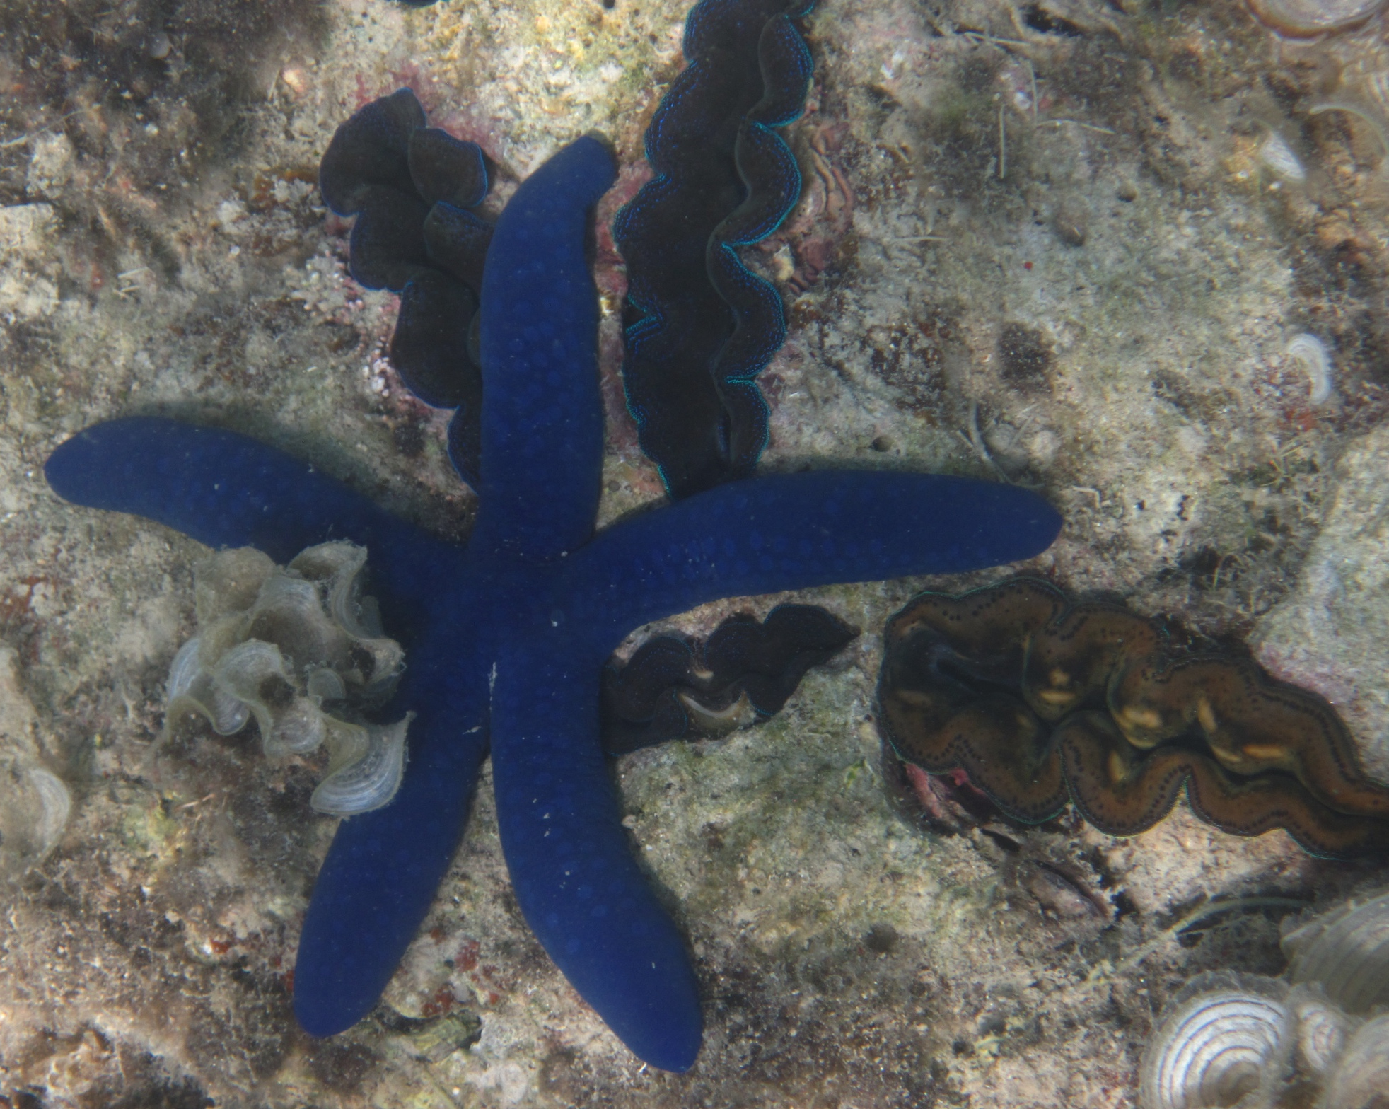
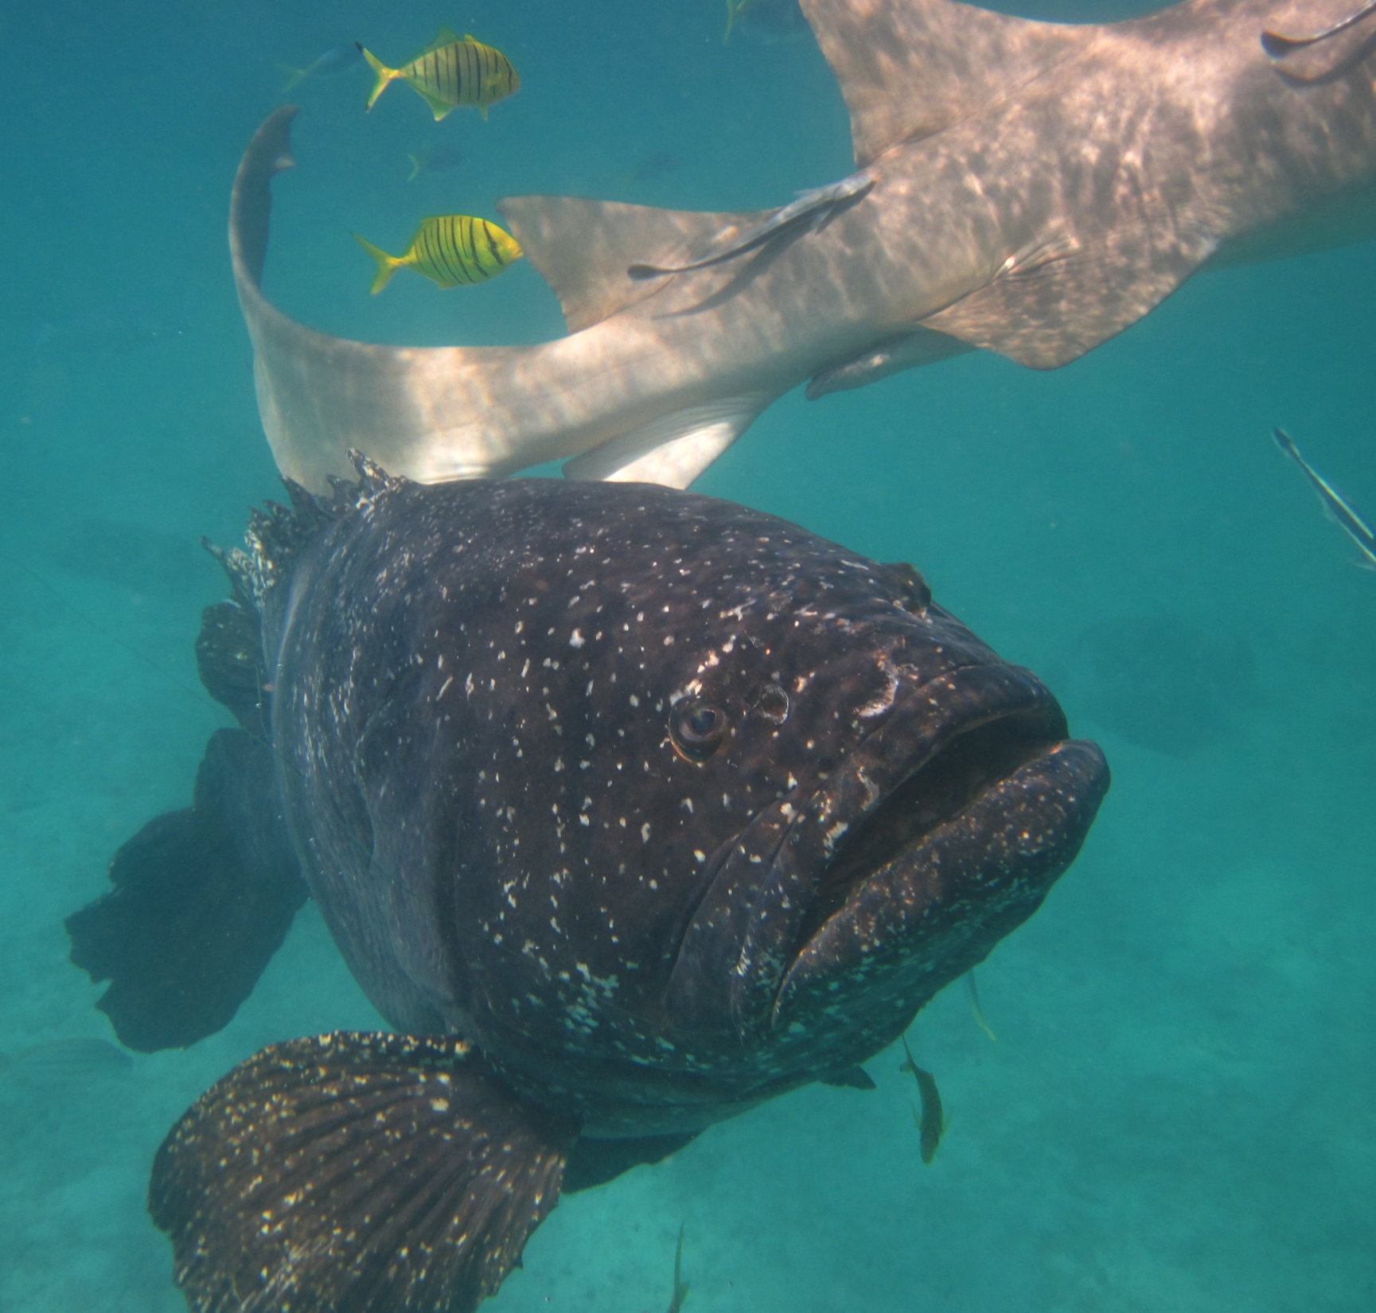
Things to do before I die… Go to the Great Barrier Reef

Slide 8
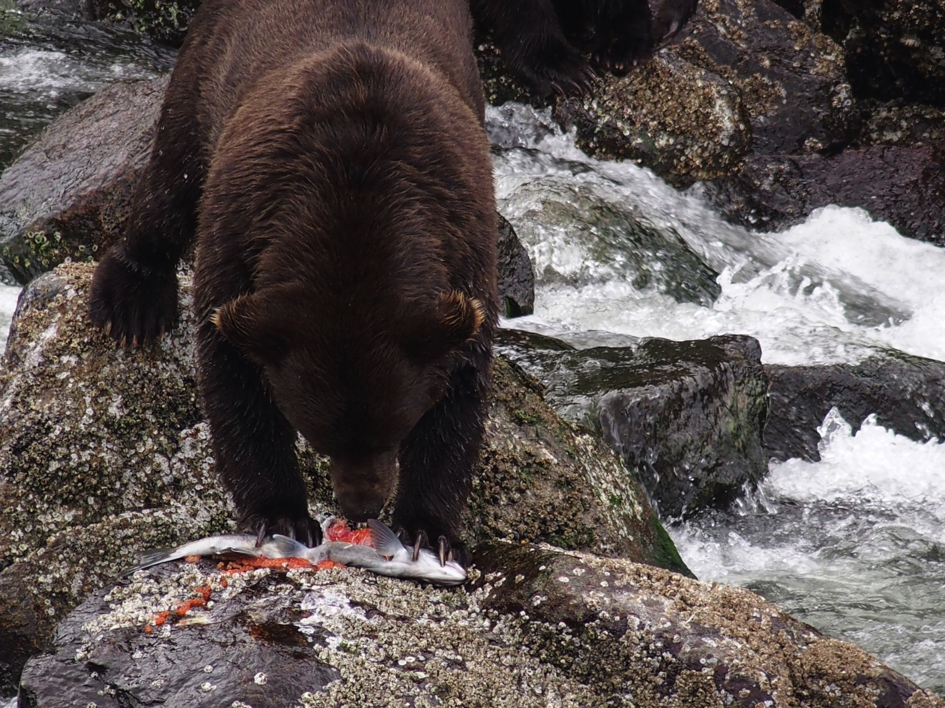
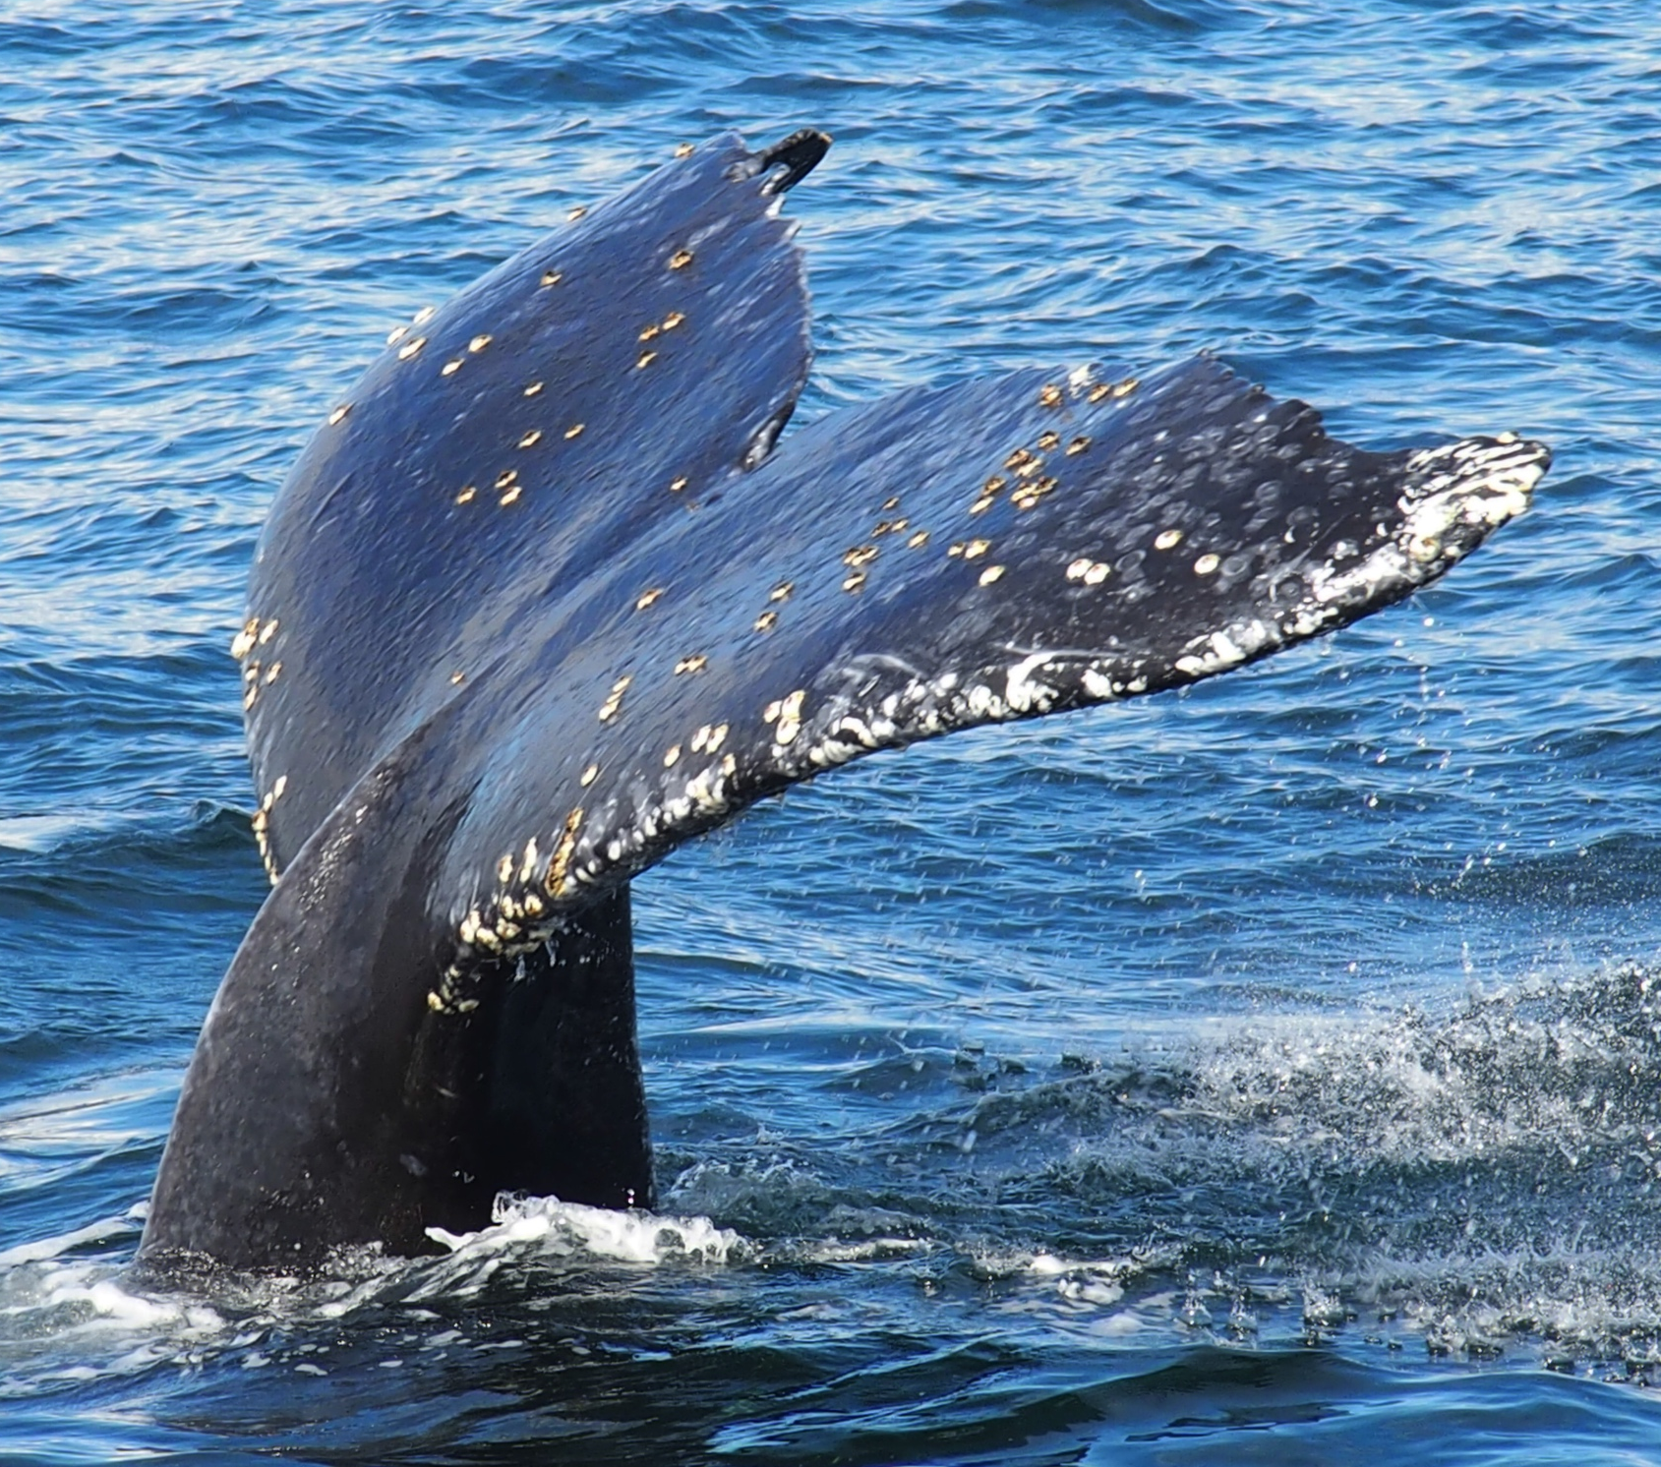
Things to do before I die… Go to Alaska

Slide 9
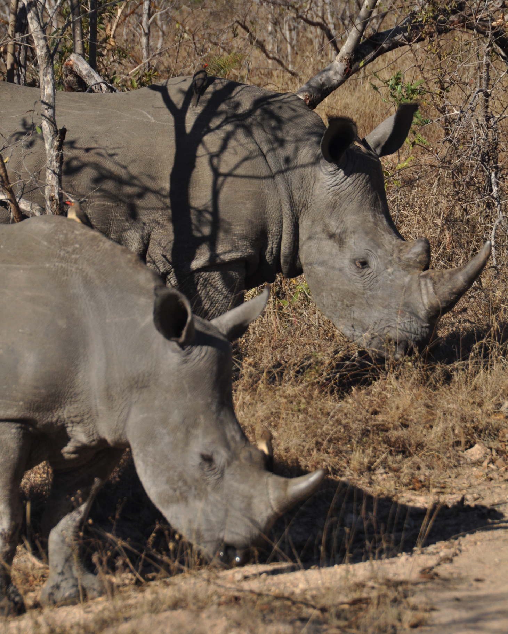
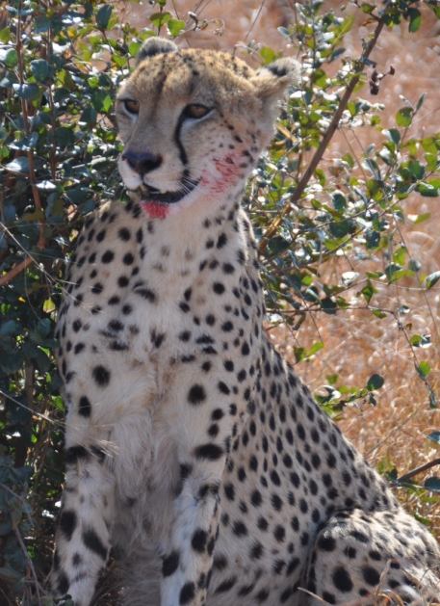
Things to do before I die… Go on safari

Slide 10
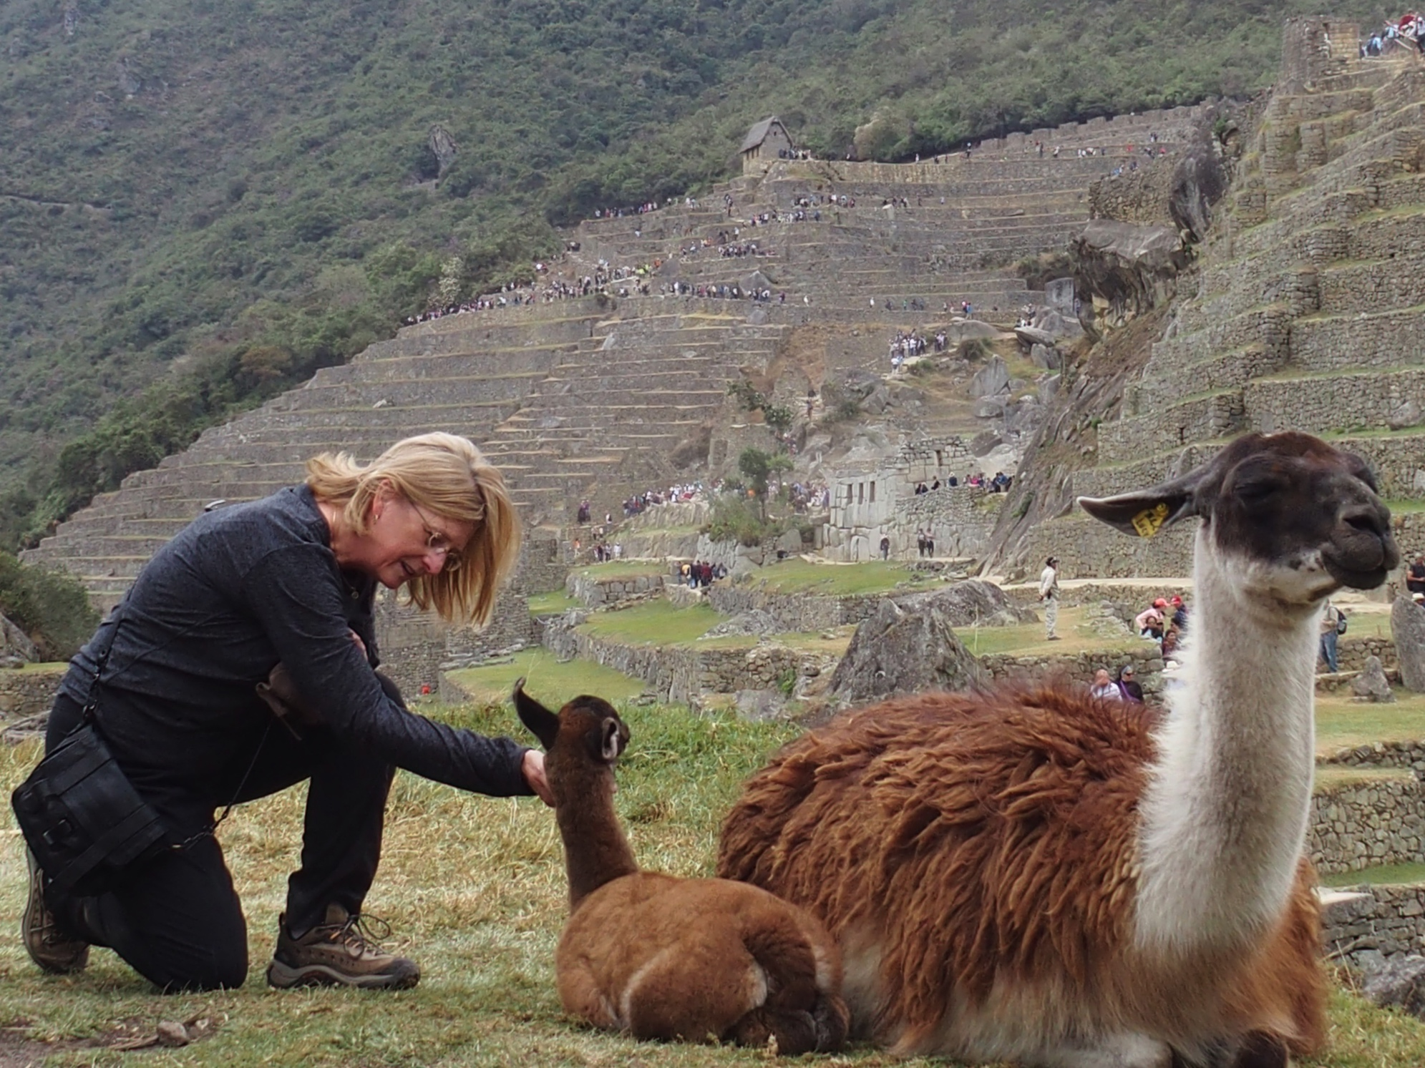
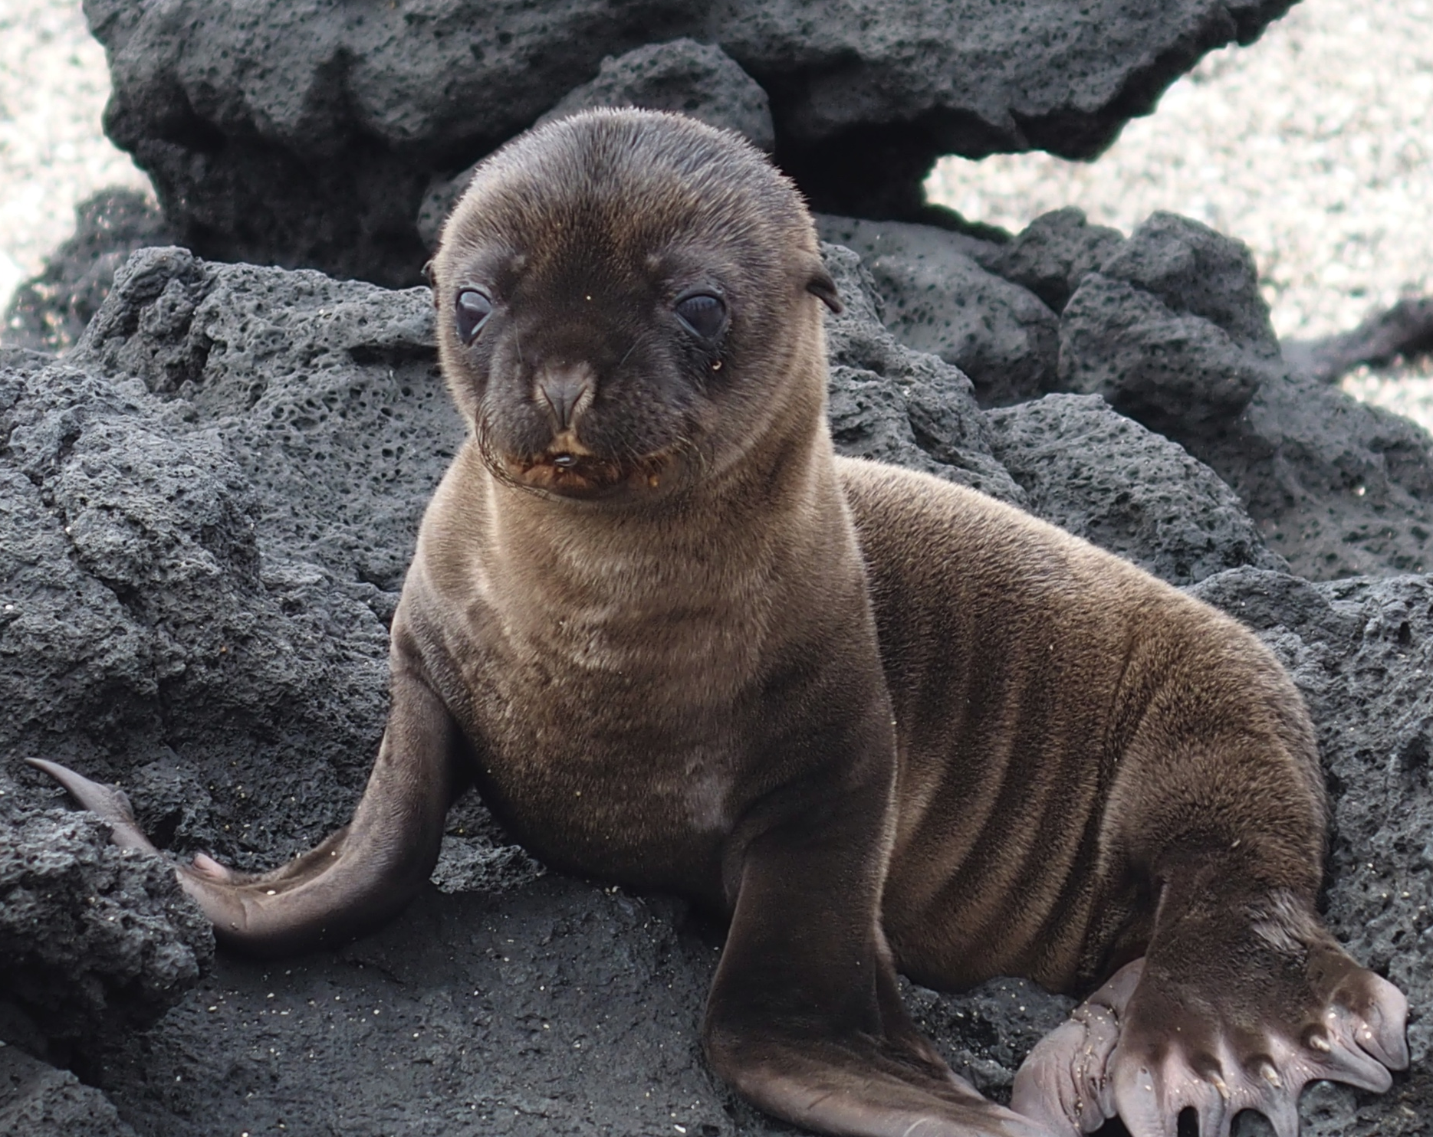
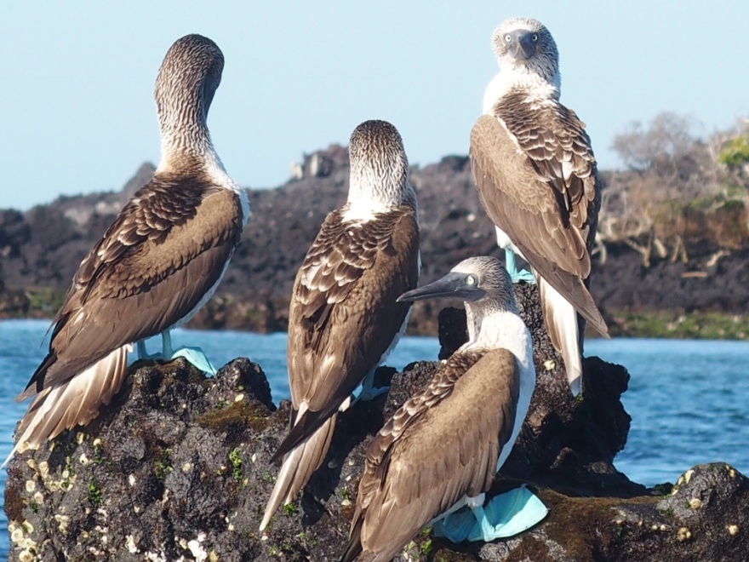
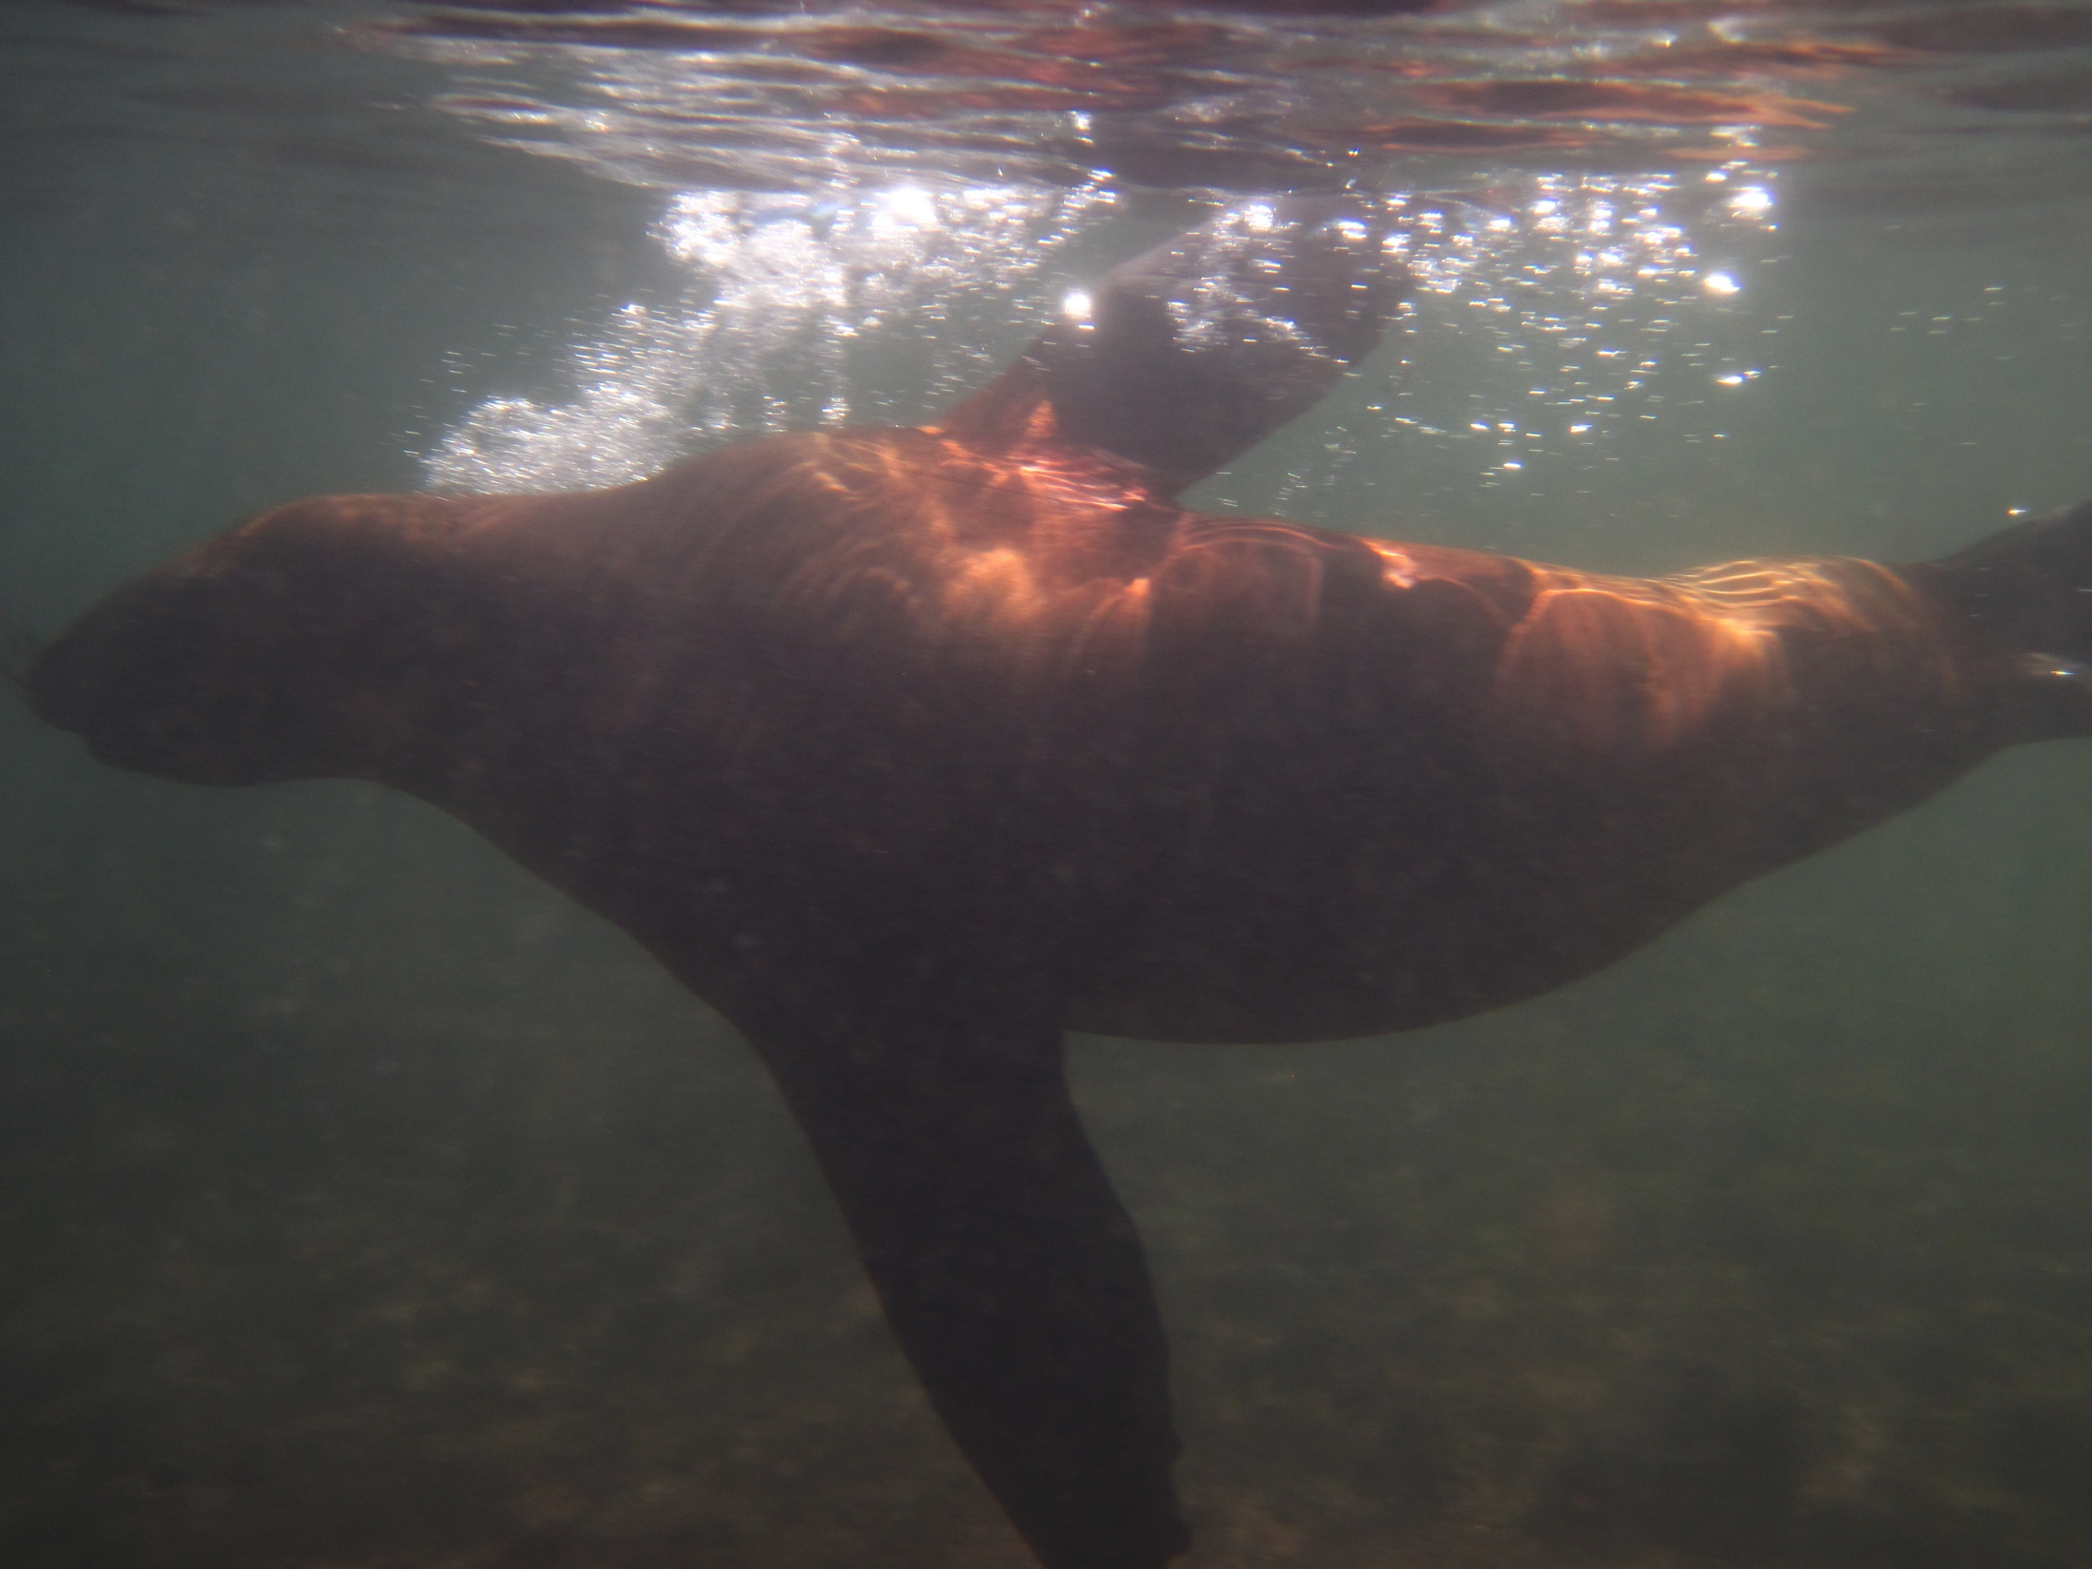
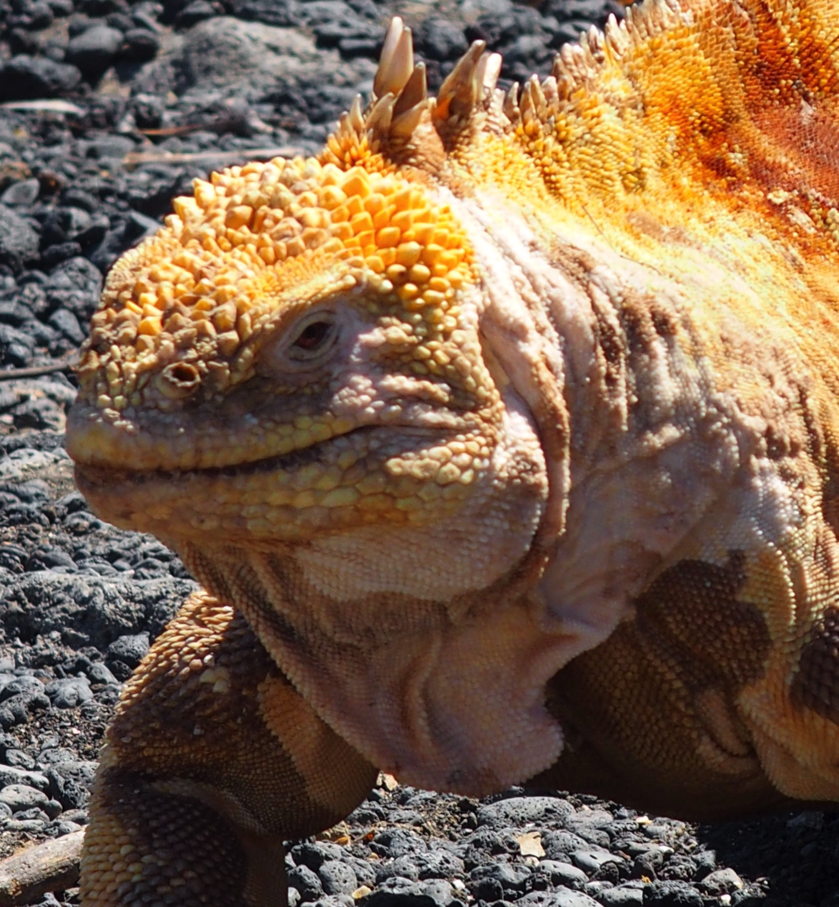
Things to do before I die… Pet a baby llama at Machu Picchu/go to Galapagos

Slide 11
Things to do before I die…
Obtain import tolerances for pesticide residues on spices

Slide 12
Import Tolerances
Project Lois Rossi outlined – EPA pilot to submit other national reviews
Currently reviewing Codex and EU tolerances to identify options
Hope to develop petition and submit by end of year
Could have word of approval in 2018

Slide 13
Import Tolerances - Issues
Best if we have support of registrant
Issues such as risk cup will by factor
Cost
$53,000 fee for submission of petition for 1 pesticide covering as many spices as data/national review support
ASTA likely to qualify for 75% small business waiver - $13,250
Plus: Ed Ruckert, Lois Rossi consulting fees for petition development/work with EPA

Slide 14
Import Tolerances
Bottom line:
There is a path forward (finally)
Will be lengthy process
Costly
Volume of tolerances will depend on available national reviews

Slide 15
Cooperation with Vietnam
New position being jointly funded by IDH (SSI), ASTA and ESA
ESA focus on compliance with EU MRLs for pesticide residues
ASTA – ban use of chemicals not permitted in US, understand current tolerance situation in US
Assuming project for import tolerances is successful US tolerances will eventually be similar to EU/Codex – support ESA focus

Slide 16
FSVP for Brokers
Recent discussions have highlighted concerns about gaps/lack of understanding of role of everyone in the supply chain on FSVP
Working to develop new FSVP Webinar to clarify roles & responsibilities
December?

Slide 17
2018 Annual Meeting
Enhanced focus on networking
Extended morning break for meetings
Rooms available to reserve in 2-hour blocks for meetings

Slide 18
2018 Pre-Conference Workshop
Economically Motivated Adulteration
John Spink of Michigan State University Food Fraud Initiative to keynote
Other speakers will look at specific problems in spice industry
Auditing schemes and how to prevent
New technologies for detection

Slide 19
QUESTIONS?

